Slide 1
LEO IR Products
D. Ghent, K. VEAL, E. Dodd, M. PERRY
U. Leicester

Slide 2
Current LEO IR Split-Window Products
Sensor | Satellite | Product levels | Period
ATSR-2 | ERS-2 | L2P (1 km), L3C (0.05°) | 1995-2003
ATSR-3 | Envisat | L2P (1 km), L3C (0.05°) | 2002-2012
MODIS | Terra | L2P (1 km), L3C (0.05°) | 2000-2020
MODIS | Aqua | L2P (1 km), L3C (0.05°) | 2002-2020
SLSTR | Sentinel-3A | L2P (1 km), L3C (0.05°) | 2016-2020
Algorithm coefficients
CCI LST Calibration Database
Brightness Temperature
Land Surface Temperature
(LST)
Sun and View angles
Processing chain
Split-Window
Probabilistic cloud mask
Water Vapour: ERA5
Uncertainty
budget
Emissivity: CAMEL
FV: Copernicus

Slide 3
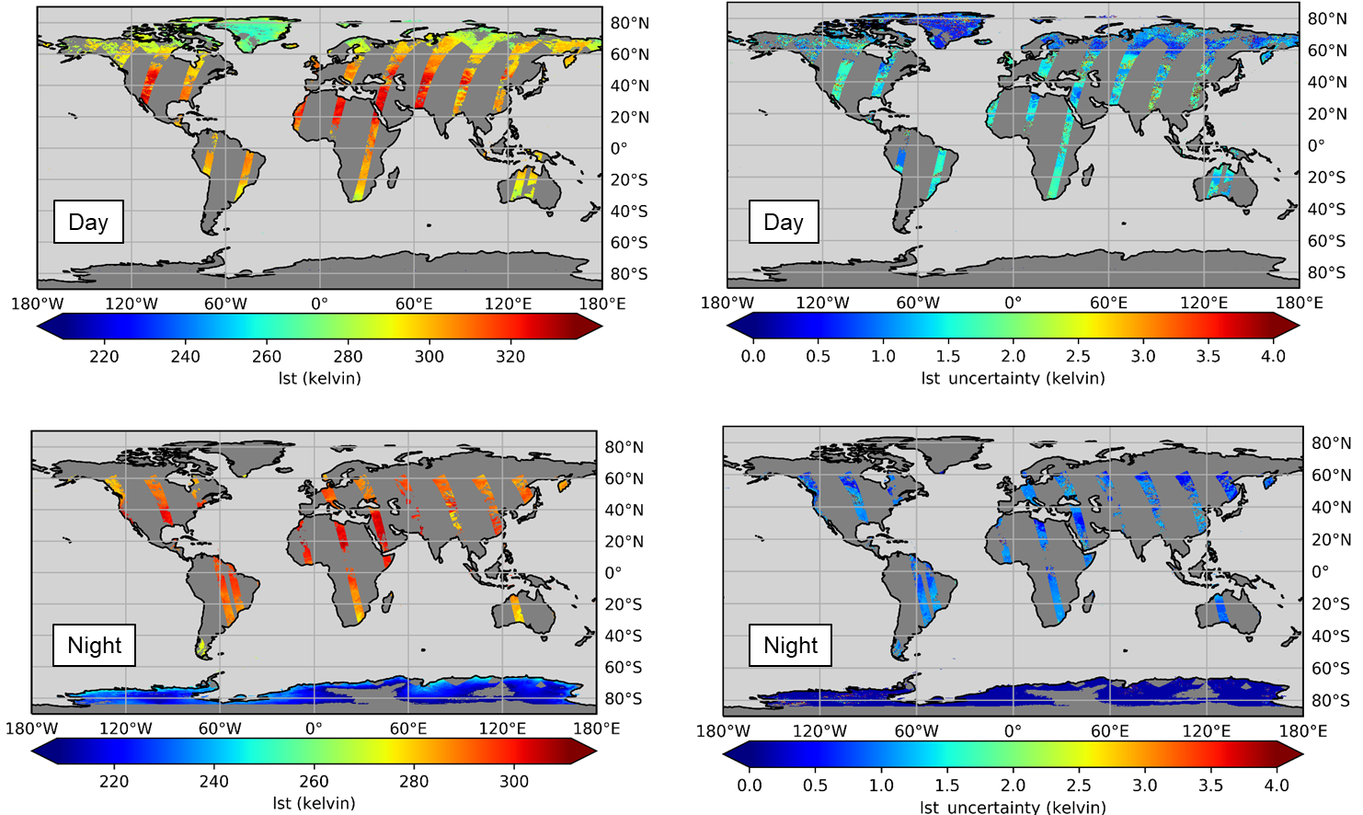
ATSR LST ECV products (ATSR-2 + AATSR)
Implemented the U. Leicester (UOL) algorithm as recommended by the Algorithm Intercomparison:
First version coefficients determined using RTTOV 11.3
First breakdown of uncertainty components by correlation properties
CCI Data Standards
Probabilistic cloud mask applied
Evolutions identified for next Cycle:
Availability of 4th re-processed L1 data
Integration of Land Cover CCI data with soil sub-types
Coefficients using new Calibration Database
CAMEL emissivity
ERA5 profiles
Investigation into temperature dependent coefficients
Further probabilistic cloud masking improvements
Further improvements to uncertainty quantification

Slide 4
MODIS LST ECV product (Terra + Aqua)
Implemented the Generalised Split Window (GSW) algorithm as recommended by the Algorithm Intercomparison:
Collection 6.0 radiances and geolocation data
Emissivity from CIMSS spatially and temporally interpolated
First breakdown of uncertainty components by correlation properties
CCI Data Standards
Evolutions identified for next Cycle:
CAMEL emissivity inputs
Coefficients to be determined using new Calibration Database:
CAMEL emissivity
ERA5 profiles
Probabilistic cloud masking expected to be improvement on operational cloud mask
Further improvements to uncertainty quantification

Slide 5
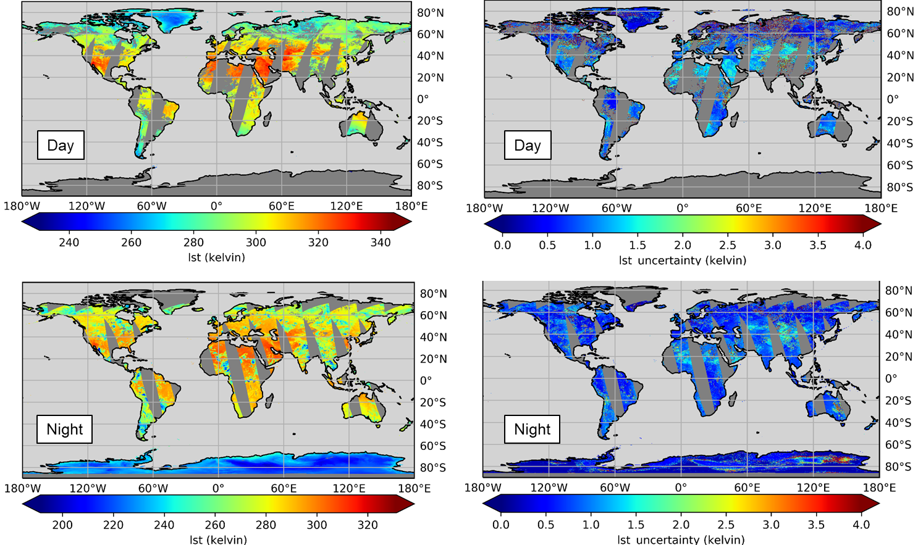
SLSTR LST ECV Products (A + B)
Implemented the U. Leicester (UOL) algorithm as recommended by the Algorithm Intercomparison:
SLSTR-A L1 data from November 2016 through to end-2018
First breakdown of uncertainty components by correlation properties
CCI Data Standards
Operational “basic” cloud masking
Evolutions identified for next Cycle:
Availability of re-processed Level-1 data
Integration of Land Cover CCI data with soil sub-types
Coefficients using new Calibration Database
CAMEL emissivity
ERA5 profiles
Probabilistic cloud masking expected to be improvement
Further improvements to uncertainty quantification

Slide 6
Developing Climate Data Records
Two IR Climate Data Records:
25-year long-term CDR from ATSR-2, AATSR, MODIS Terra, and SLSTR (1995 – 2020)
Merged GEO and Merged LEO products
LST is retrieved from the different instruments using the same algorithm
However, need to account for:
Inter-instrument calibration differences
Observation time differences (e.g. ATSR-2 and Terra 10.30; AATSR and SLSTR 10.00)
Using IASI BTs as calibration reference
GSICS used IASI as the reference sensor in a calibration of SEVIRI radiances
Aligning LSTs to a common reference time
In GlobTemperature ATSR-2 was aligned with AATSR using matchups during the overlap period (~ 1yr): monthly average corrections for each month, for each land cover class were calculated where there were sufficient matchups and global values used elsewhere.
In CCI we are using MODIS Terra as a reference making use of the longer overlap periods to model corrections by land cover class, time of year, day/night and latitude

Slide 7
Temperature and emissivity separation from MODIS multispectral TIR data
J. A. Sobrino, d. skoković, J.C. Jimenez, D. SALINAS
GLOBAL CHANGE UNIT
UNIVERSITY OF VALENCIA

Slide 8
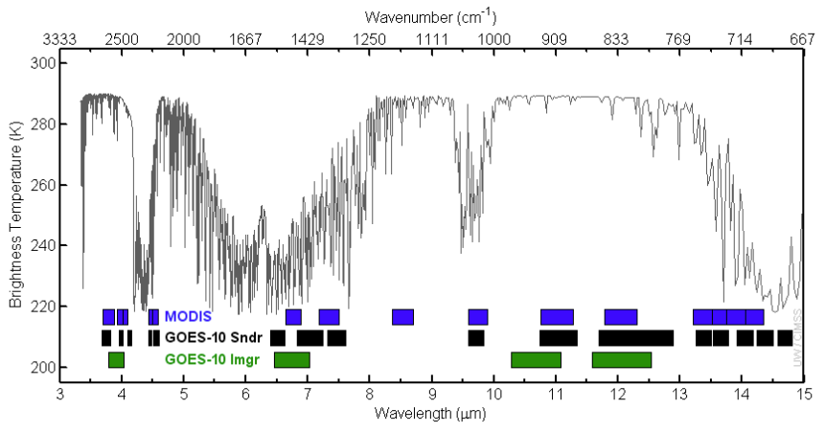
TES from MODIS multispectral TIR data
TES ALGORITHM
Selection of the most transparent MODIS thermal bands (b29, b31 & b32)
TES uses input image data (previously corrected from $L_{up}$ & $τ$) of surface radiance $L_{sur}$ and $L_{down}$ to solve the Radiative Transfer Equation
MMD-Emissivity regression extracted from ECOSTRESS library

Slide 9
TES from MODIS multispectral TIR data
TES PROCESSING CHAIN
Flow diagram shows all steps in the retrieval process in generating the MODIS TES product starting with interpolation and atmospheric profiles generation and progressing through atmospheric correction (RTTOV), TIR at-sensor radiances and finally, the TES algorithm.
scheme used to process all MODIS dataset
ERA5
Land &
Atmospheric profiles
START
MODIS data
At-sensor radiances
Spatial resolution: 1 Km
MOD03
MOD02
Atmospheric parameters
Transmissivity
Up-welling radiance
Down-welling radiance
Spatial resolution: 1 Km
Pressure
Temperature
Rel. Humidity
Spatial resolution: 0.25º
Zenith angle & Altimeter data
Spatial resolution: 1 Km
Application of TES algorithm
Products:
LST
LSE 29, 31 & 32
Bilinear interpolation of ERA 5 variables to 1 Km spatial resolution
Use of MODIS altimeter to establish the initial altitude of the atmospheric profile.
Atmospheric profiles
Spatial resolution: 1 Km
RTTOV process of each atmospheric profile
FINISH
Process elapsed time ~3 min

Slide 10
TES from MODIS multispectral TIR data
UVEG TES vs MYD21
MYD21
UVEG TES
$$ε_{min}=0.997+0.705{MMD}^{0.743}$$
$$ε_{min}=0.998+0.654{MMD}^{0.736}$$
MERRA-2
0.625°×0.5°
42 pressure levels
Time res. 6 hours
MERRA-2 profiles interpolation to 1 km by the use of Water Vapor Scaling (WVS) correction
RTTOV processor for
Transmissivity
Upwelling radiance
Downwelling radiance
ERA-5
0.25°×0.25°
137 pressure levels
Time res. 1 hour
ERA-5 Land pressure level at 2 m added
ERA-5 profiles interpolation to 1 km and adjustment to MODIS altimeter data to establish the initial altitude of the atmospheric profile
RTTOV processor for
Transmissivity
Upwelling radiance
Downwelling radiance
Main differences between products come from the atmospheric correction input
Other difference is the emissivity estimation obtained from the MMD-$ε_{min}$ relation which can led to different LST & LSE estimations
Validation of UVEG product performed by the intercomparison against MYD21 product on 07/07/2017. A total of 264 images have been processed. Daily composite image was produced for validation.

Slide 11
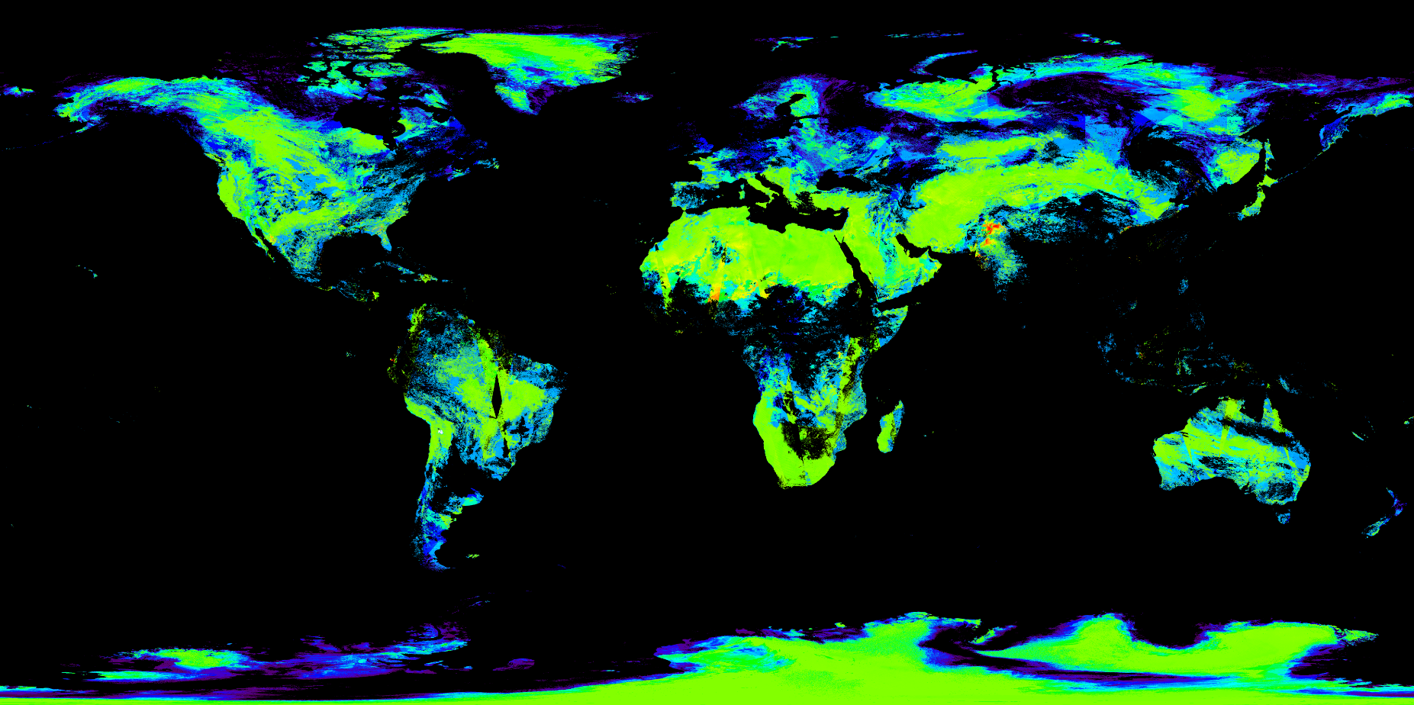
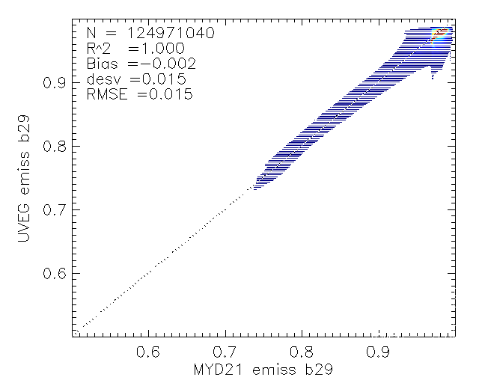
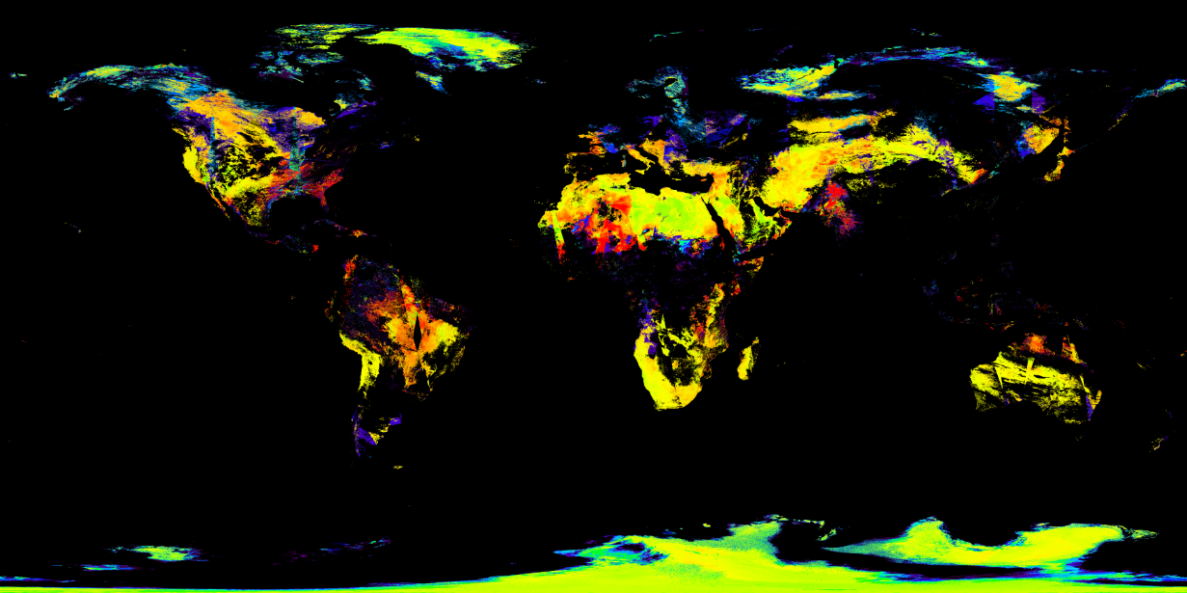
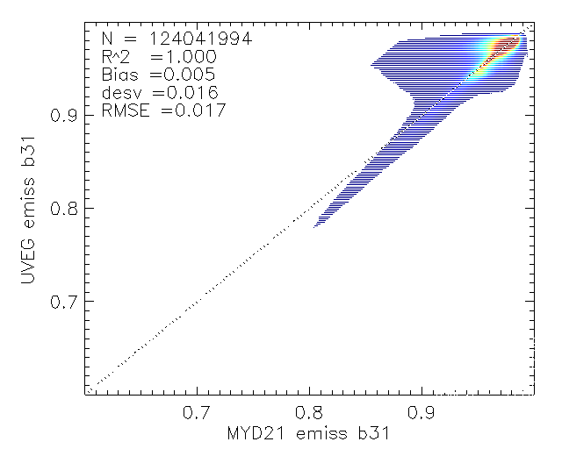
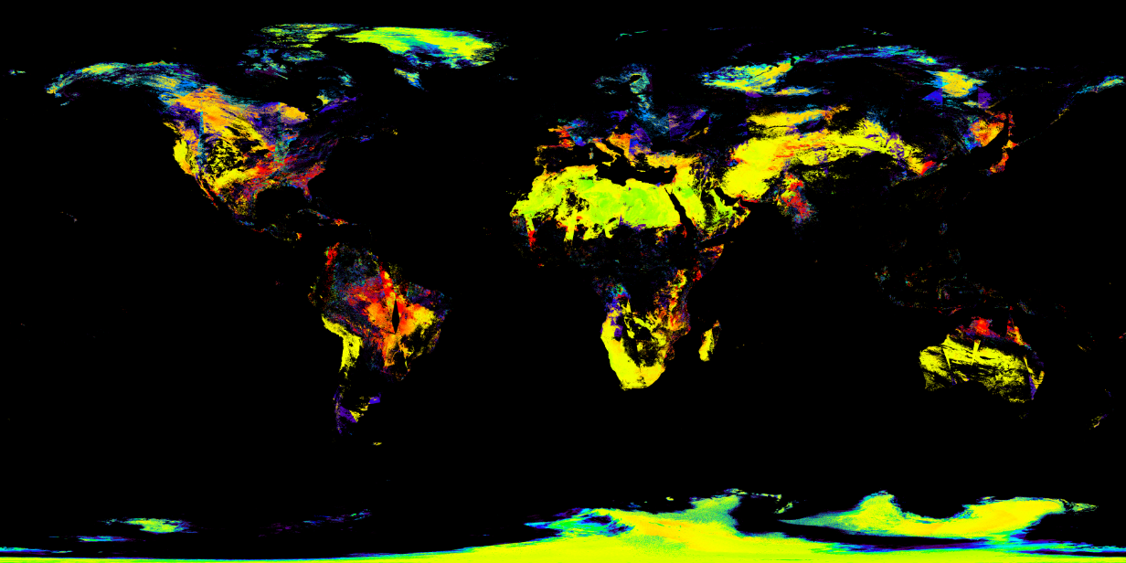
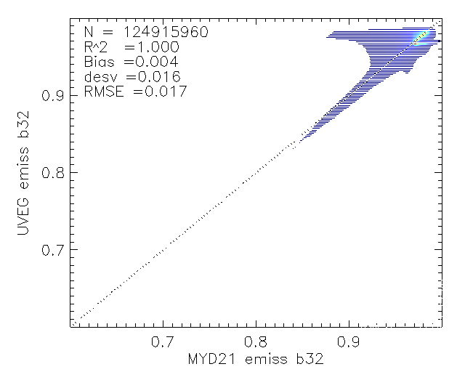
LSE INTERCOMPARISON
1 Km UVEG minus MYD21
RMSE of 0.015 b29
RMSE of 0.017 b31, b32
dLSE b29
-0.06 -0.03 0 0.03
dLSE b31
-0.06 -0.03 0 0.03
dLSE b32
-0.06 -0.03 0 0.03

Slide 12
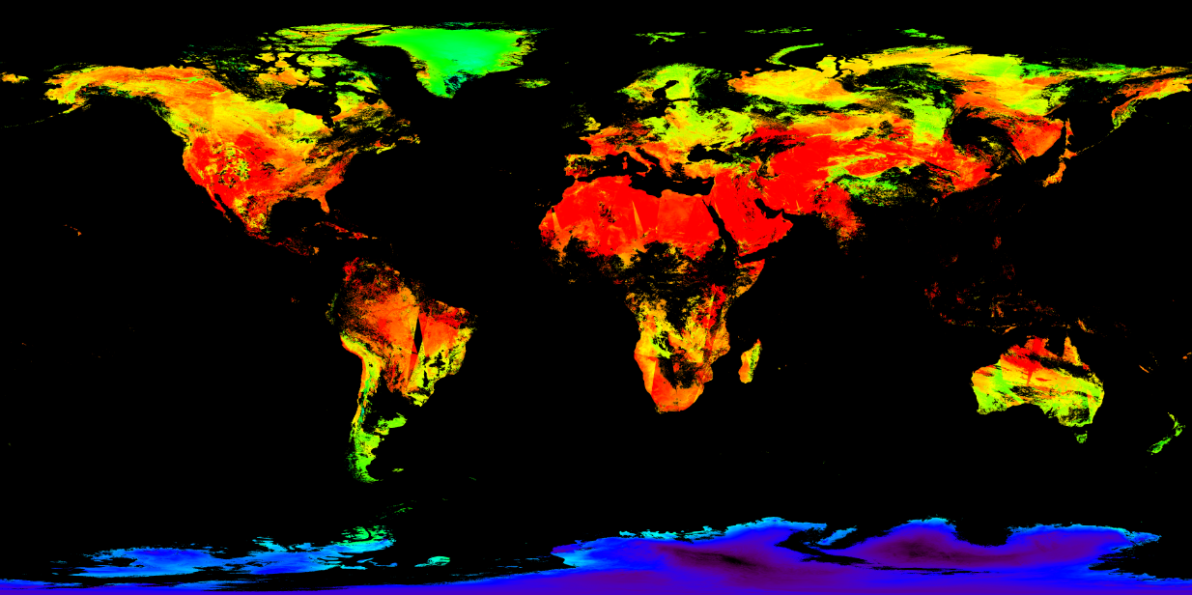
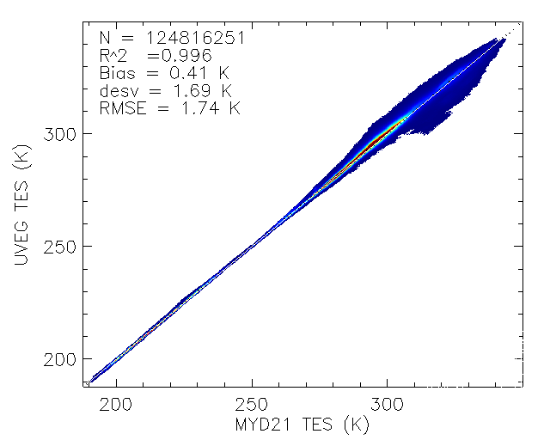
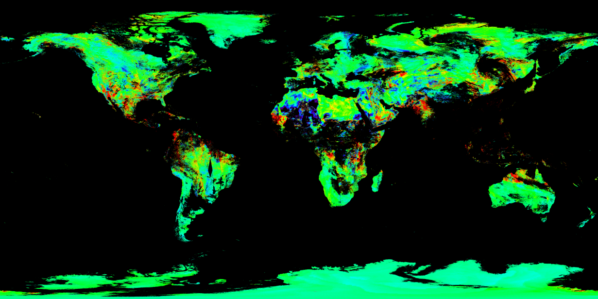
TES from MODIS multispectral TIR data
LST INTERCOMPARISON
1 Km UVEG minus MYD21
LST UVEG
200 225 250 275 300 325
LST (K)
dLST
-4 -2 0 2 4
dLST (K)
UVEG TES
vs
MYD21 TES
CONCLUSIONS
LSE: RMSE of 0.015 between TES algorithms.
LST: RMSE of 1.7 K.
UVEG TES product tested against MYD21 data, in situ validation is required to fully test the validity of the product.
MODIS imagery on CEDA database will be processed on Jasmin supercomputer

Slide 13
GEO IR PRODUCTS
Sofia ermida, Ipma
Isabel Trigo, IPMA

Slide 14
GEO IR products
Sensor | Satellite | Product levels | Period
SEVIRI | MSG 1-4 | L2P, L3U, L3C | 2004-2020
IMAGER | GOES 12-13 | L2P, L3U, L3C | 2009-2017
ABI | GOES 16 | L2P, L3U, L3C | 2018-2020
JAMI | MTSAT 1-2 | L2P, L3U, L3C | 2009-2015
ABI | HIMAWARI | L2P, L3U, L3C | 2016-2020
SEVIRI:
Split-window
Hourly
GOESN:
single-channel
Hourly/3-hourly
GOES-R:
Split-window
Hourly
MTSAT:
single-channel
Hourly
HIMAWARI:
split-window
2 TIR channels
1 TIR channel

Slide 15
GEO IR products
Algorithm coefficients
CCI LST Calibration Database
Brightness Temperature
MSG/GOES/MTSAT
sun and view angles
Land Surface Temperature
(LST)
Cloud mask
NWP/LSA SAF
Processing chain
Split-Windows/ single channel
Total Column Water Vapour (TCWV)
ERA5
Uncertainty
budget
Emissivity
CAMEL

Slide 16
Merged GEO IR Product
MTSAT
GOES
MSG

Slide 17
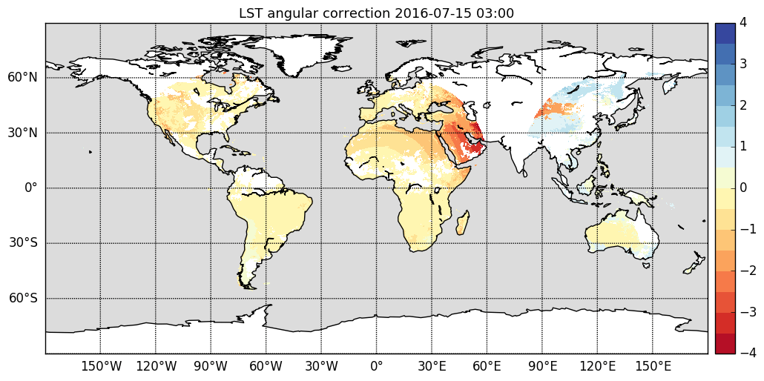
LST angular effects
Estimation of LST angular effects using parametric models

Slide 18
LST_cci products: Microwave LST
C. JIMENEZ, C. PRIGENT, S. FAVRICHON
Estellus

Slide 19
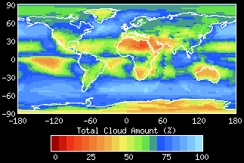
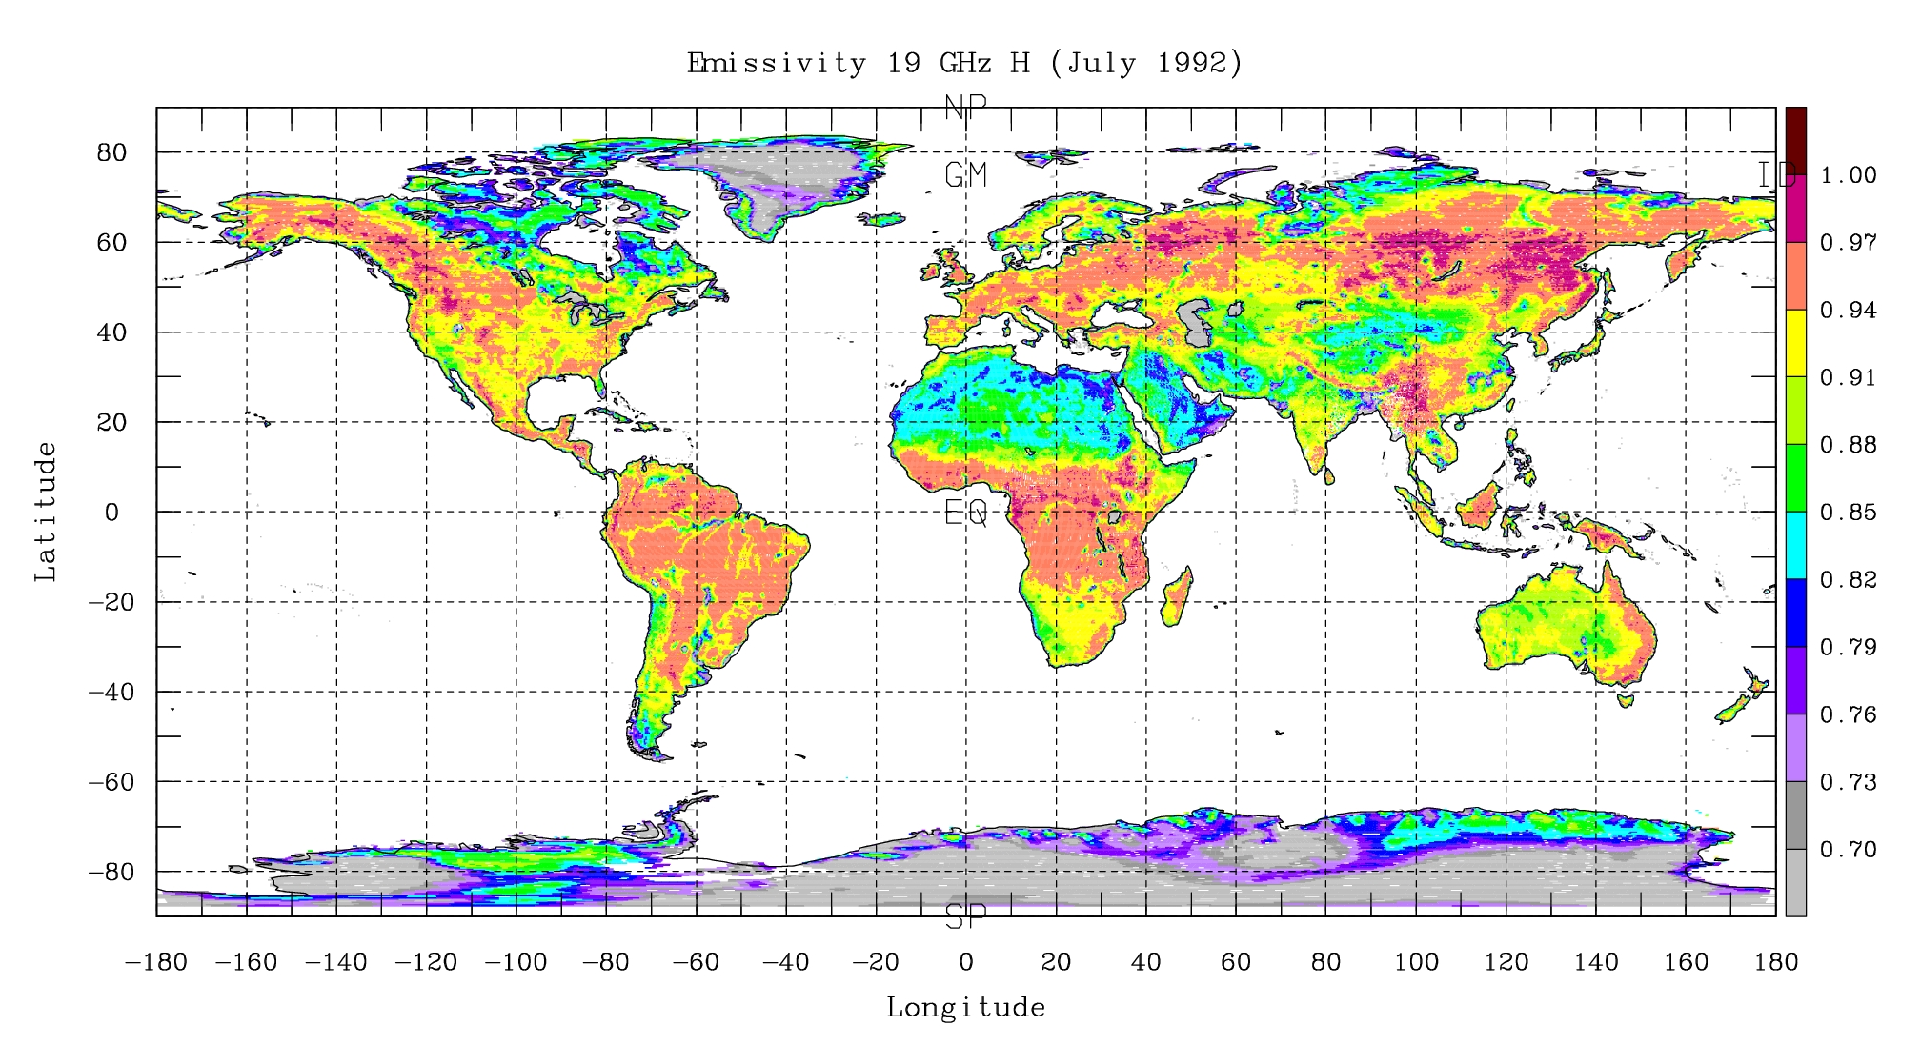
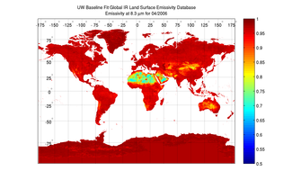
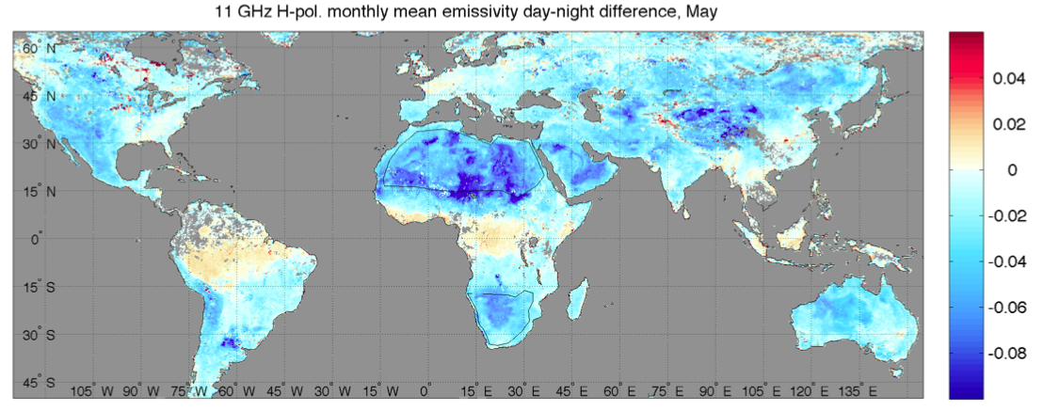
Microwave LST: motivation
ISCCP cloud cover (%)
How to obtain observation-based estimates of all-weather LST?
Passive microwaves in window channels can penetrate clouds,
Challenges:
- more sensitivity to the emissivity e_{MW}, that varies with vegetation, soil moisture…
Tb ~ e_{MW} LST
lower frequencies have larger penetration depth; in very arid places MWs observe a temperature integrated over a few cms below the surface, differing from the skin temperature measured in the IR
e_{IR}
e_{MW}
e_{MW}[day] - e_{MW}[night]

Slide 20
Microwave LST: products
Sensor | Satellite | Product levels | Period
SSM/I | DMSP F13 | L2P, L3C | 1995-2008
SSMIS | DSMP F17 | L2P, L3C | 2009-2017
SSMIS | DMSP F18 | L2P, L3C | 2018-2020
PRODUCTS
L2P – swath L3C - gridded
Algorithm coefficients
MW Database
calibrating a regression based on NNs
INVERSION ALGORITHM
Land Surface Temperature
(LST)
Brightness Temperature
SSM/I SSMIS
Processing chain
calibrated NN
Emissivity
TELSEM
Uncertainty
budget

Slide 21
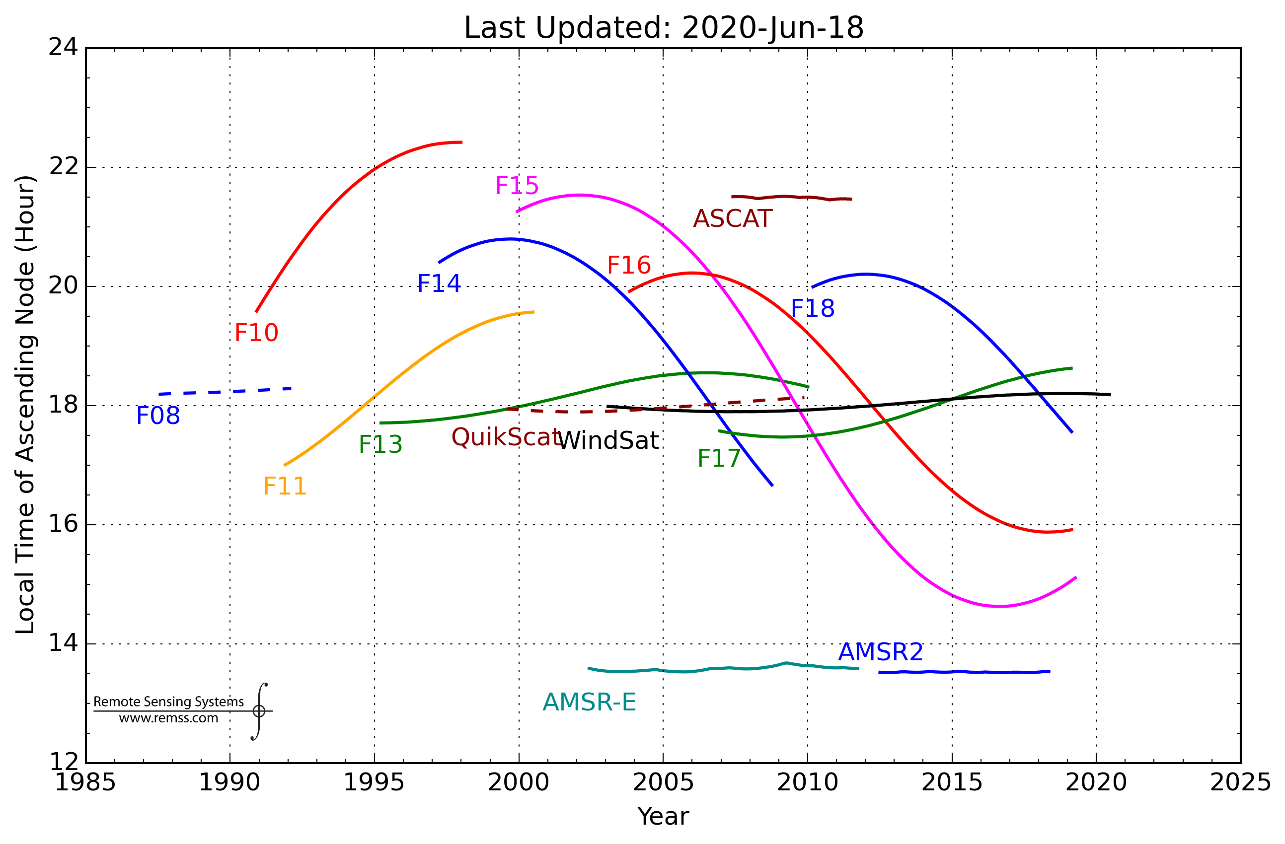
Microwave LST: satellite selection
DMSP satellites do not have system to stabilize their orbits, so orbit injection and orbital drift affect the observing local time. F13, F17, and F18 are selected to minimize change in an observing local time around 6 AM/PM;
F13
F17
F18
Local time drift and discontinuity when changing satellite still exists and need to be taken into consideration. A LST correction to homogenize the time series to a constant local time is under study.

Slide 22
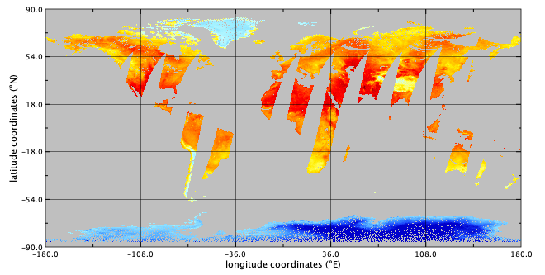
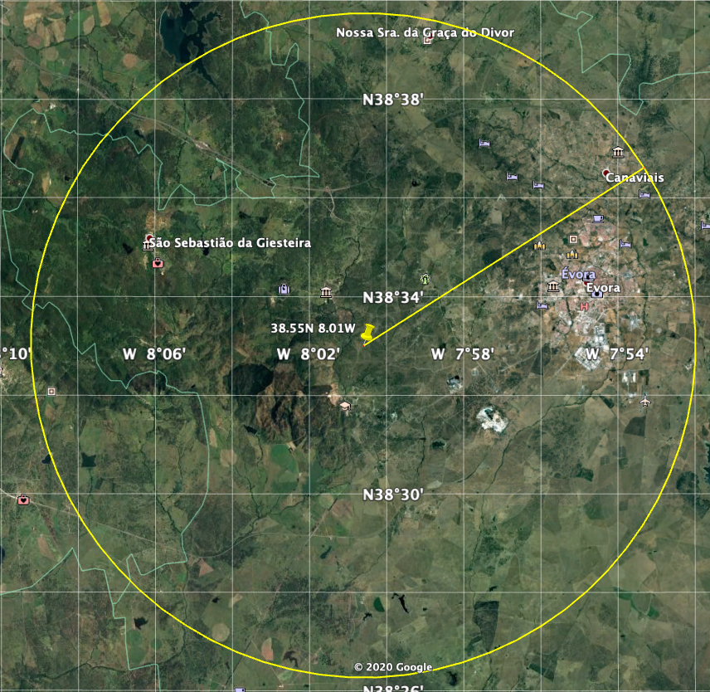
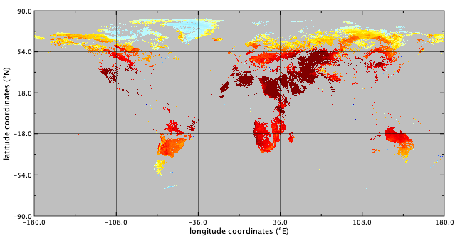
Microwave LST: coverage/resolution/errors
Daily coverage
Space resolution
2006/06/06
SSM/I ~6AM
12 km
simulated SSM/I footprint
MODIS ~1.30PM
Evora LST station
- Polar satellites, so twice per day (~6 AM/PM), with a sensor swath of ~1700 km and no cloud missing LST.
- Resolution of ~25 km2, much coarser than the IR sensors; downscaling techniques currently under investigation.
- Expected to be larger than the IR LST due to the more varying emissivity; preliminary internal evaluation at a sample of LST stations showing a ~4K RMSD.
Retrieval errors

Slide 23
Microwave LST: applications
Unique dataset in terms of providing a measurement of non-clear-sky biased LST, possibly best suited for large scale climate studies and model evaluation.
examples of time series of area-integrated LST
Antarctica, Dome-C
Sahara, Grand Erg Oriental
1996
2009
2016
2018

