Slide 1
TerrA-P: Exploitation of a combined use of Sentinel-3 fAPAR & LST data for primary production estimates
LST cci User Workshop 2020
Roel Van Hoolst – VITO Remote Sensing

Slide 2
Primary Production
C0₂
f( ,…)
0₂
_{Organic compounds}

Slide 3
Gross Primary Production (GPP)
Expressed as carbon/biomass
_{Gross Primary Production (GPP)}
C
Photosynthetic reduction of CO₂ into organic compounds
Per unit area
[g C / m2 / day]
Per unit time interval

Slide 4
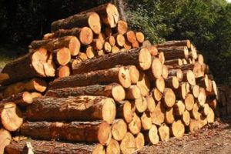
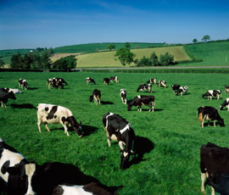
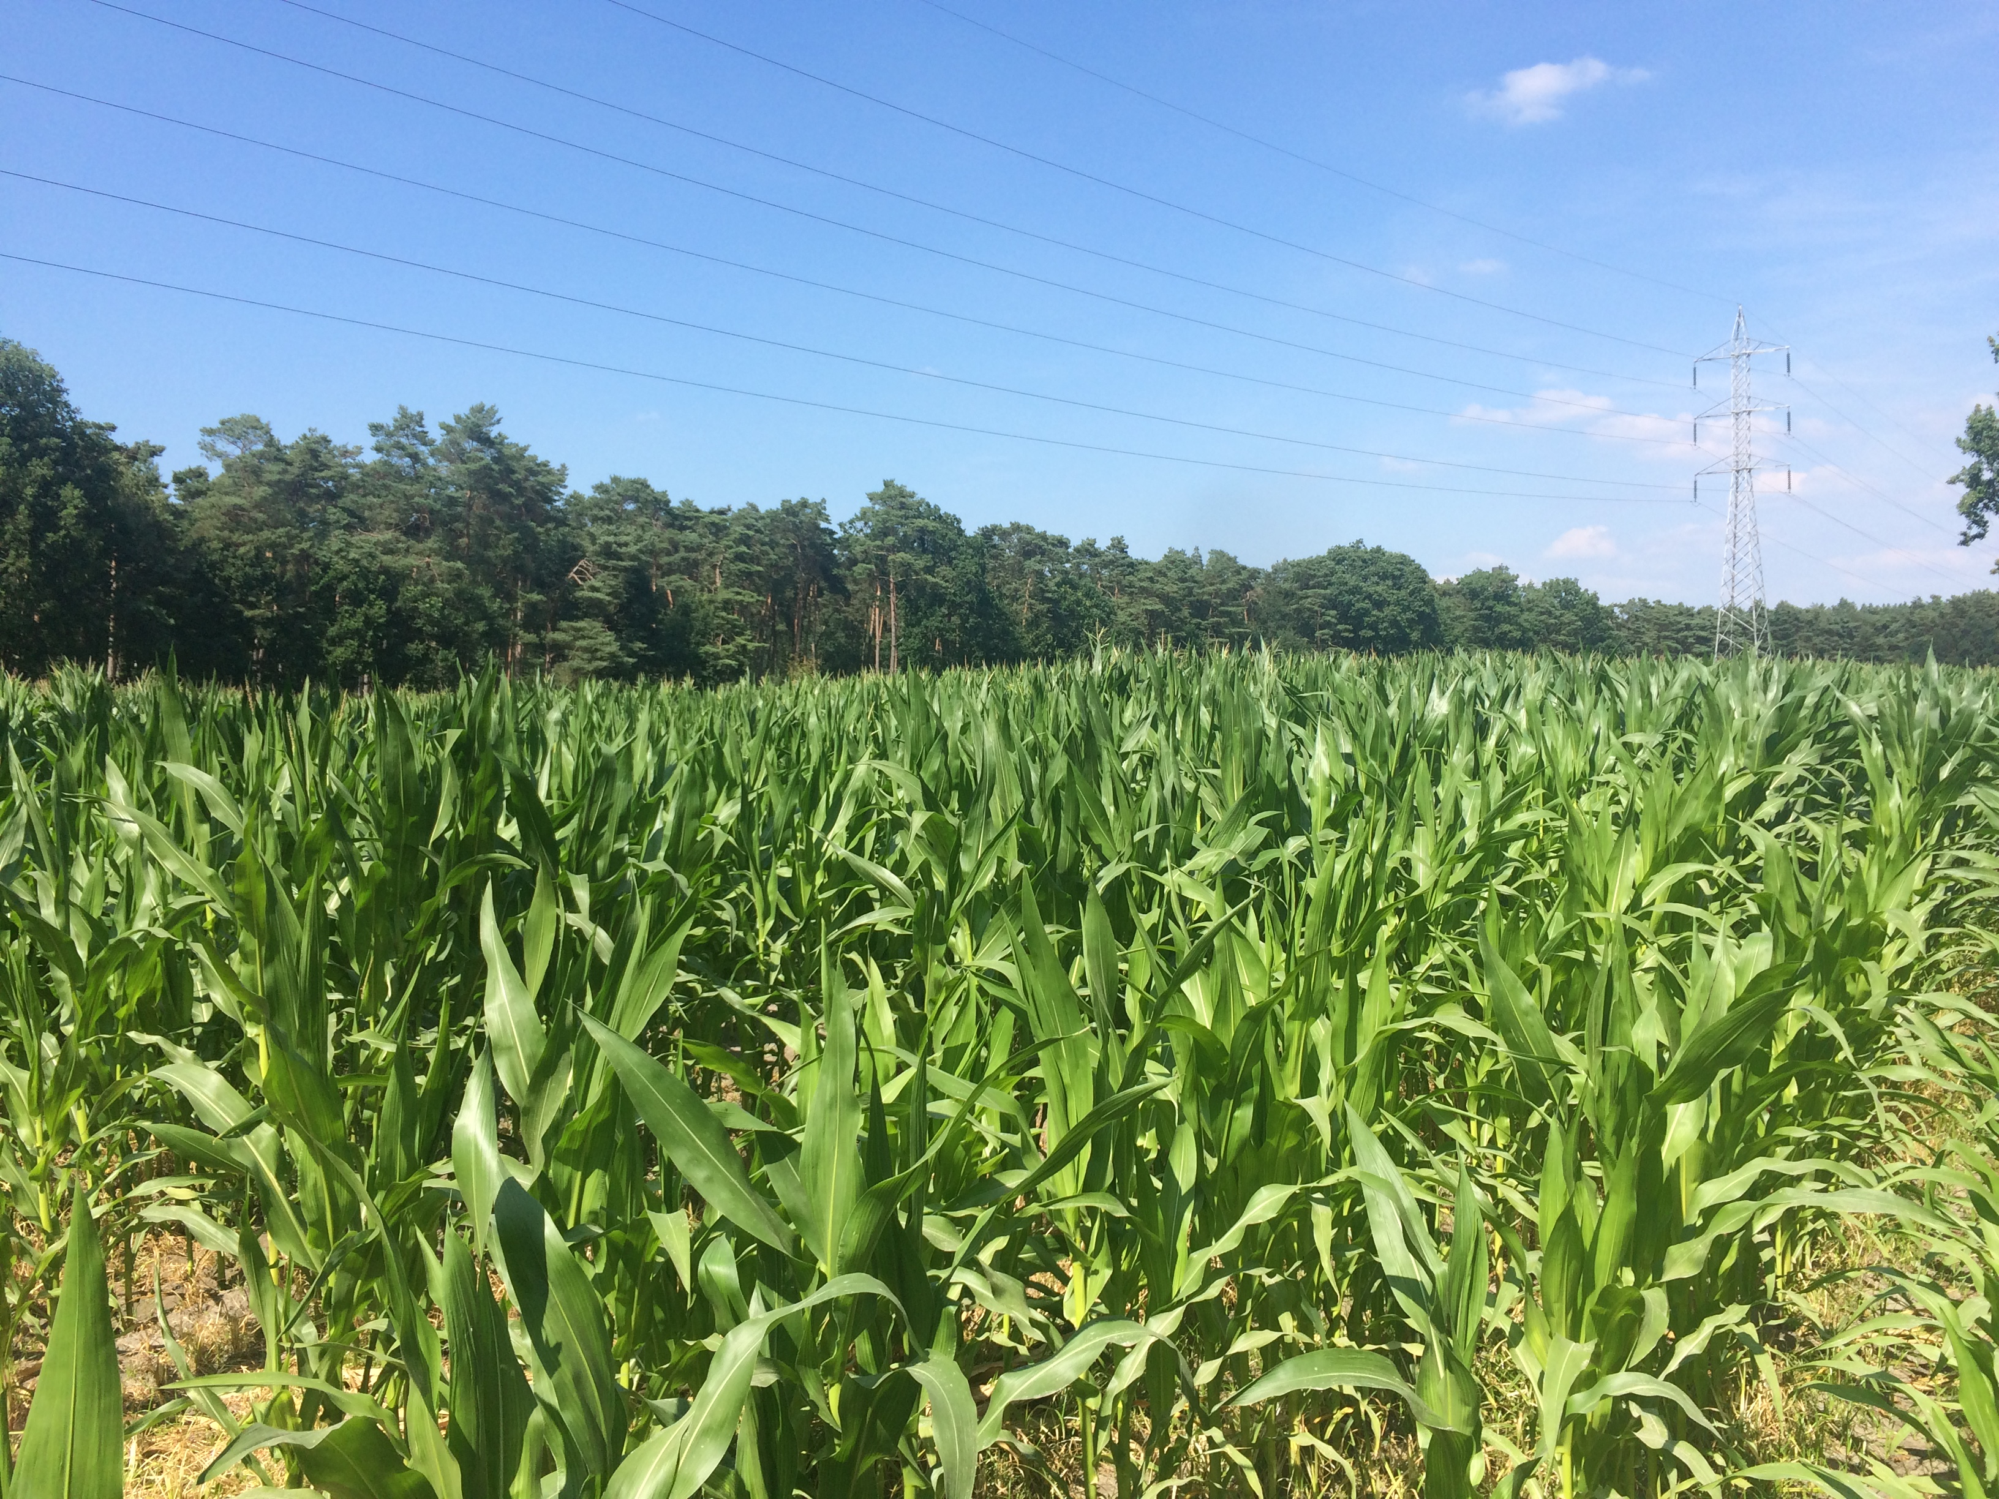
Aboveground biomass production (ABP)

Slide 5
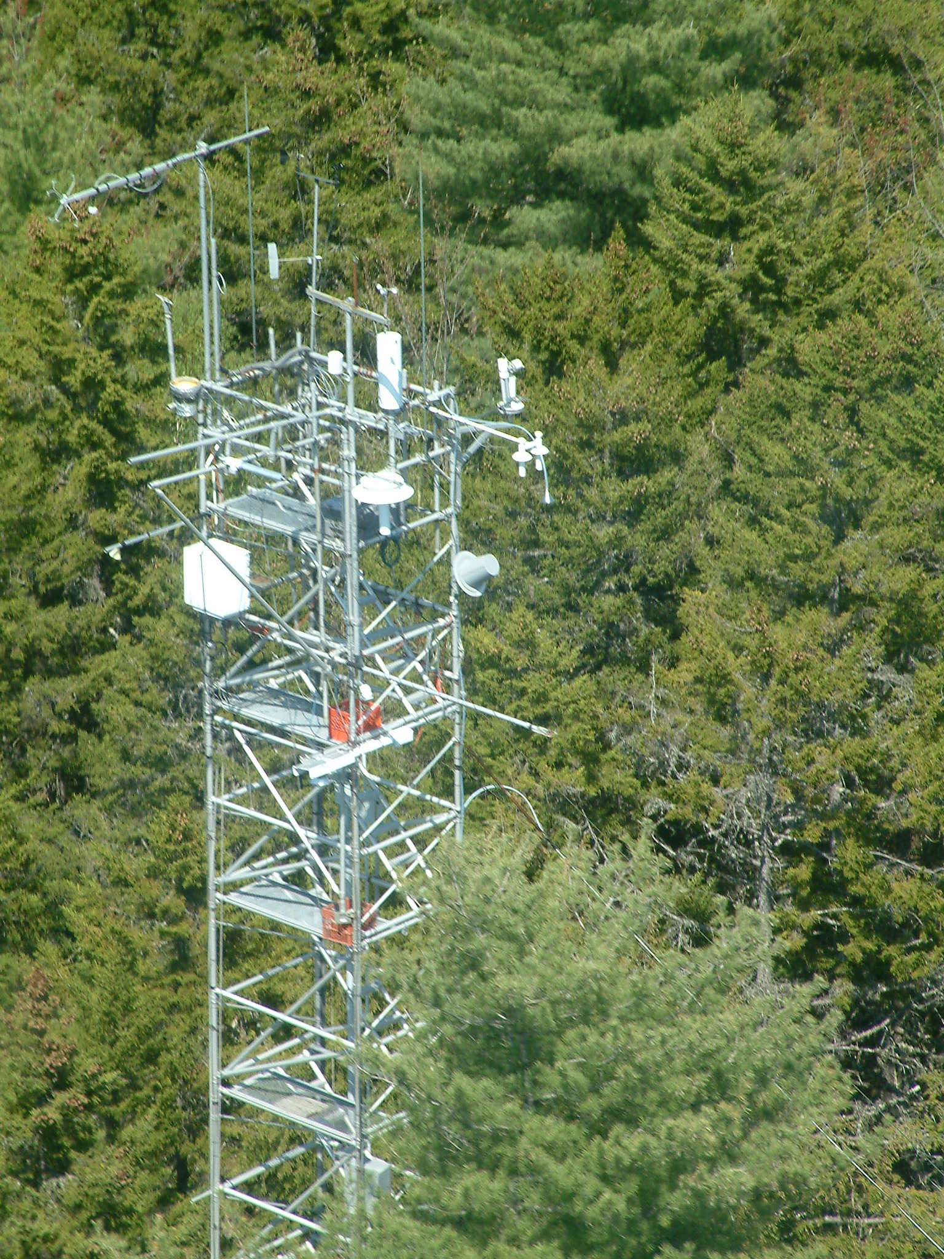
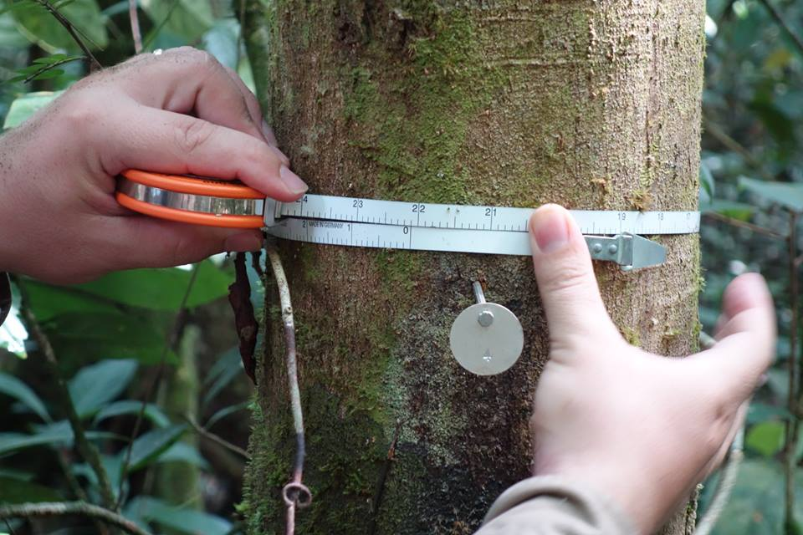
How do we measure/estimate GPP/ABP?
ABP
GPP
In-situ
Global
In-situ
Global
Models
Models

Slide 6
TerrA-P: Scientific Exploitation of Sentinel 3 for GPP/ABP
Definition
P-model
Imperial College London (ICL)
Implementation
EO data & processing
VITO remote sensing
Validation
FLUXNET & ABP in-situ
University of Antwerp

Slide 7
The P-model
Form of a Light Use Efficiency model
No discontinuities at biome boundaries
Physiological effects of atmospheric CO2
Universal: calibration based on 1 parameter
C3 version & C4 version
Wang, H., I.C. Prentice et al. 2017
Wang, H., I.C Prentice, W.M. Cornwell, T.F. Keenan, T.W. Davis, I.J. Wright, B.J. Evans and C. Peng (2017) Towards a universal model for carbon dioxide uptake by plants. Nature Plants 3: 734–741.

Slide 8
GPP modelling
Meteo data
Solar radiation
vapour pressure
P-model
GPP
+ uncertainties
fAPAR
Temperature
LST or Tair
CO₂

Slide 9
GPP models & drought
fAPAR -> accounts for reduced photosynthesis caused by moderate droughts or dry seasons in most biomes
EO based GPP models typically underestimate the effect of extreme droughts & dry seasons in a number of biomes (e.g. Mediterranean forests)
Could be corrected by including soil moisture information, but with additional challenges:
Requires additional modelling components
Reliability of soil moisture estimates in full canopy vegetation
Hypothesis: LST reflects the effect of restricted transpiration and thus reduced photosynthesis

Slide 10
Use of LST in GPP models
Potential benefits:
Closely linked to canopy temperature
Enhanced spatial detail
Data parsimony to include drought effects
Identified challenges:
Sparse vegetation
Account for diurnal cycle
Clouds

Slide 11
TerrA-P results
So far:
Model cal/val on historical data (ENVISAT fAPAR/LST)
Comparison of air temperature against LST model
Global demonstration on ENVISAT/Sentinel 3 (reduced res. LST)

Slide 12
2 examples for 2018 – Sentinel 3 [preliminary results]
Belgium – forest site
Belgium – cropland site
* Full res. fAPAR
* Reduced res. 0,05° LST

Slide 13
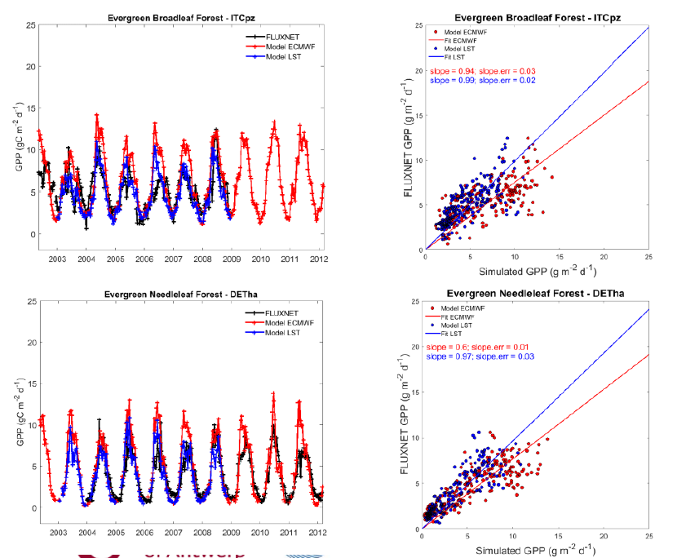
Use of LST instead of Tair
Mediterranean forest
General findings:
Accuracy at Flux sites:
Pmodel(LST) > Pmodel(Tair)
Can reproduce the effect of external soil moisture stress component
Forest in
Germany
2007
drought

Slide 14
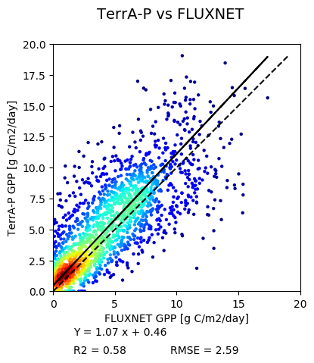
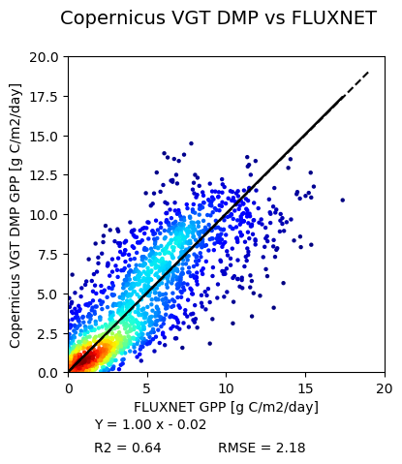
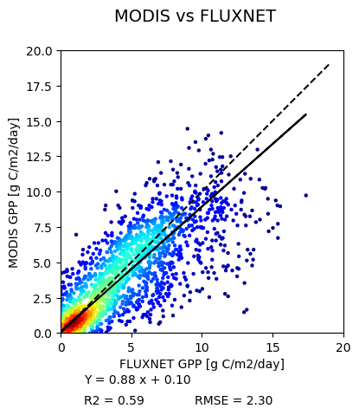
Comparison with CGLOPS & MODIS
Results on
TerrA-P validation sites

Slide 15
Sentinel 3: Global 2018 dataset
Required pre-processing: gap-filling & smoothing

Slide 16
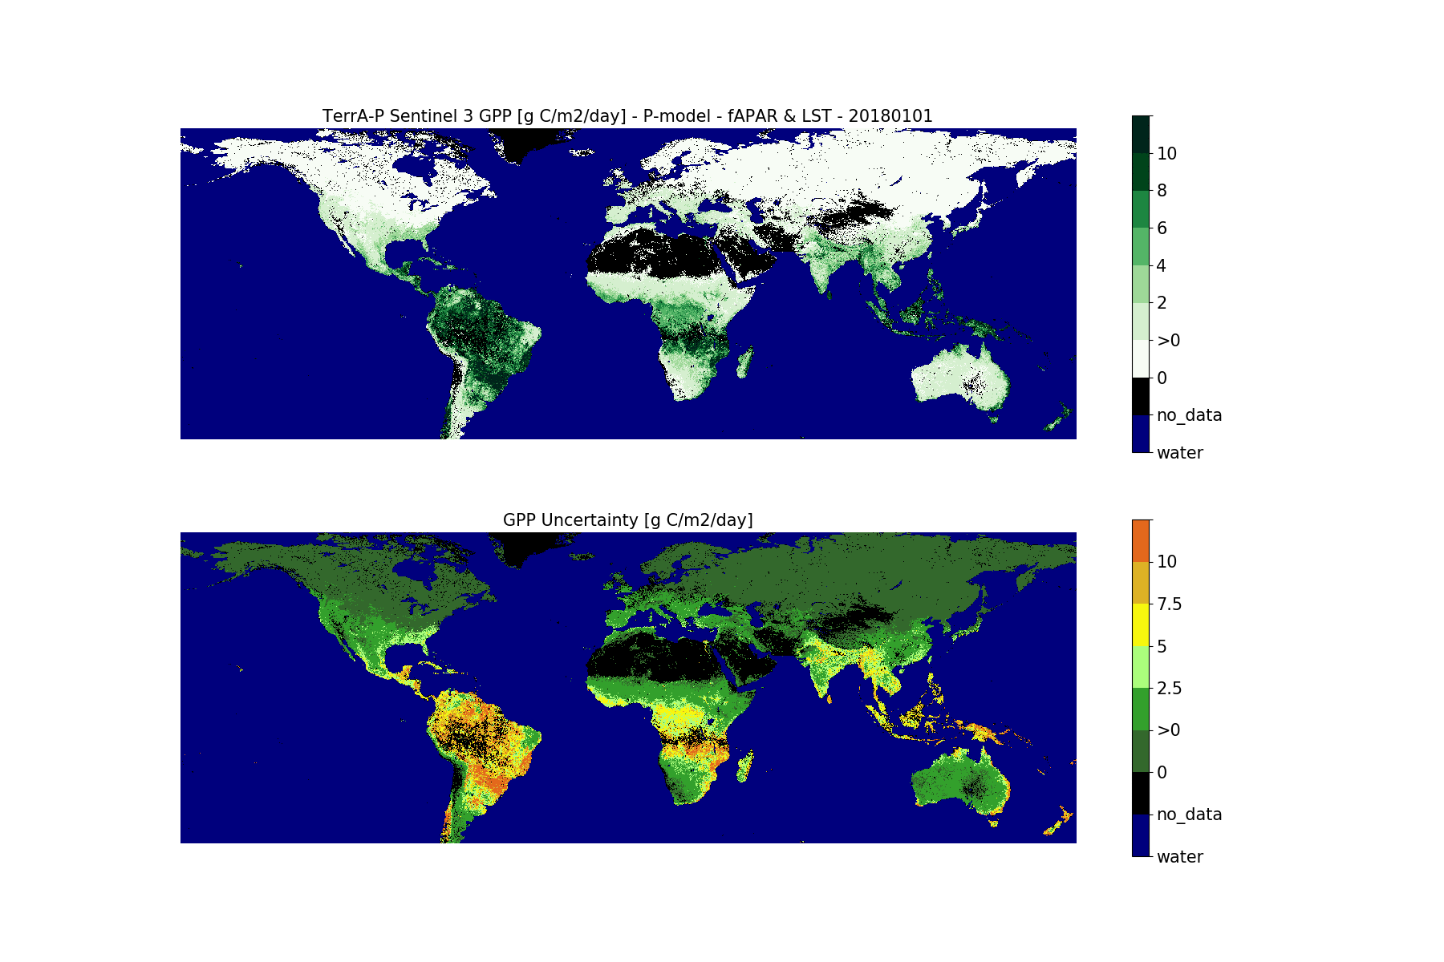
TerrA-P
Global Sentinel 3 GPP
fAPAR 500m
LST 0,05°
ECMWF meteo 0,25°
10-daily
Jan-Dec 2018
*Combination of C3/C4 images
masked for water pixels
combined “flag” values in “no_data”
uncertainty calculation magnitude overestimated
-> update planned

Slide 17
Planned R&D – TerrA-P follow-up
Additional GPP in-situ data:
Already available: ICOS drought initiative 2018
In preparation: ICOS COVID-19 initiative (data until 2020)
Improved P-model
Assessment of LST challenges:
Impact of diurnal cycle
Sparse vegetation
Full resolution Sentinel 3 European GPP data 2018-2019

Slide 18
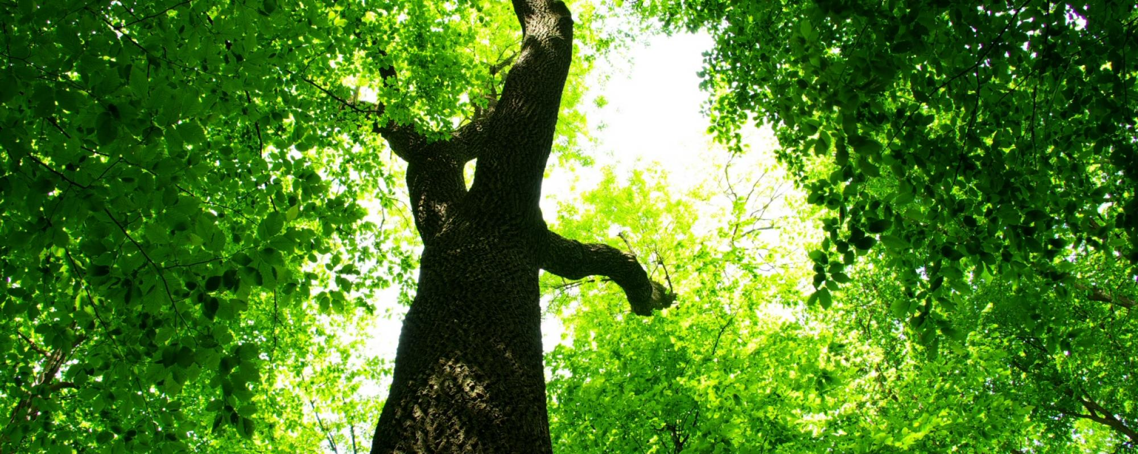
Thanks to TerrA-P contributors:
VITO: Else Swinnen
Imperial College of London: Colin Prentice & colleagues
University of Antwerp: Ivan Janssen, Manuela Balzarolo, Sara Vicca
University of Leicester: Darren Ghent
ESA: Philippe Goryl, Fabrizio Niro
Brockmann Consult: Carsten Brockmann

